Slide 1


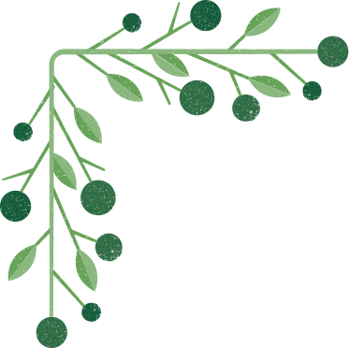


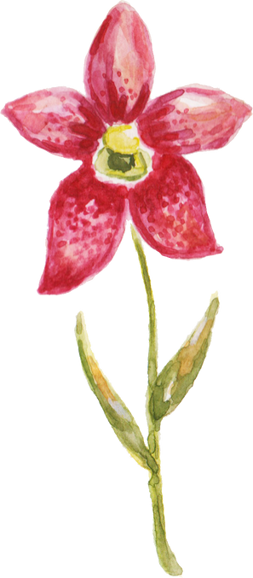


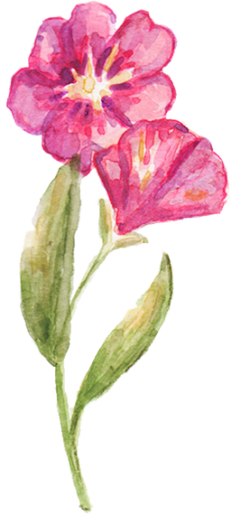
Nurture:
Autonomous Plant Care System
Sddec24-16
Cameron Jones, Chase O’Connell, Cayden Kelley,
Blake Hardy, Tejal Devshetwar, Holden Brown
Advisor: Md Maruf Ahamed

Slide 2

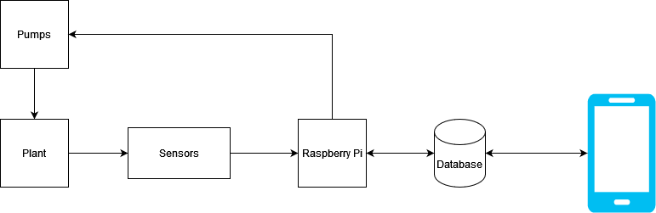

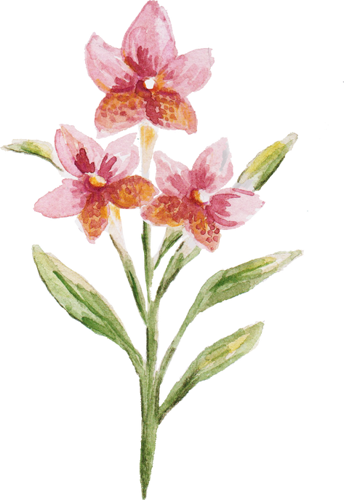
Project Overview

Slide 3
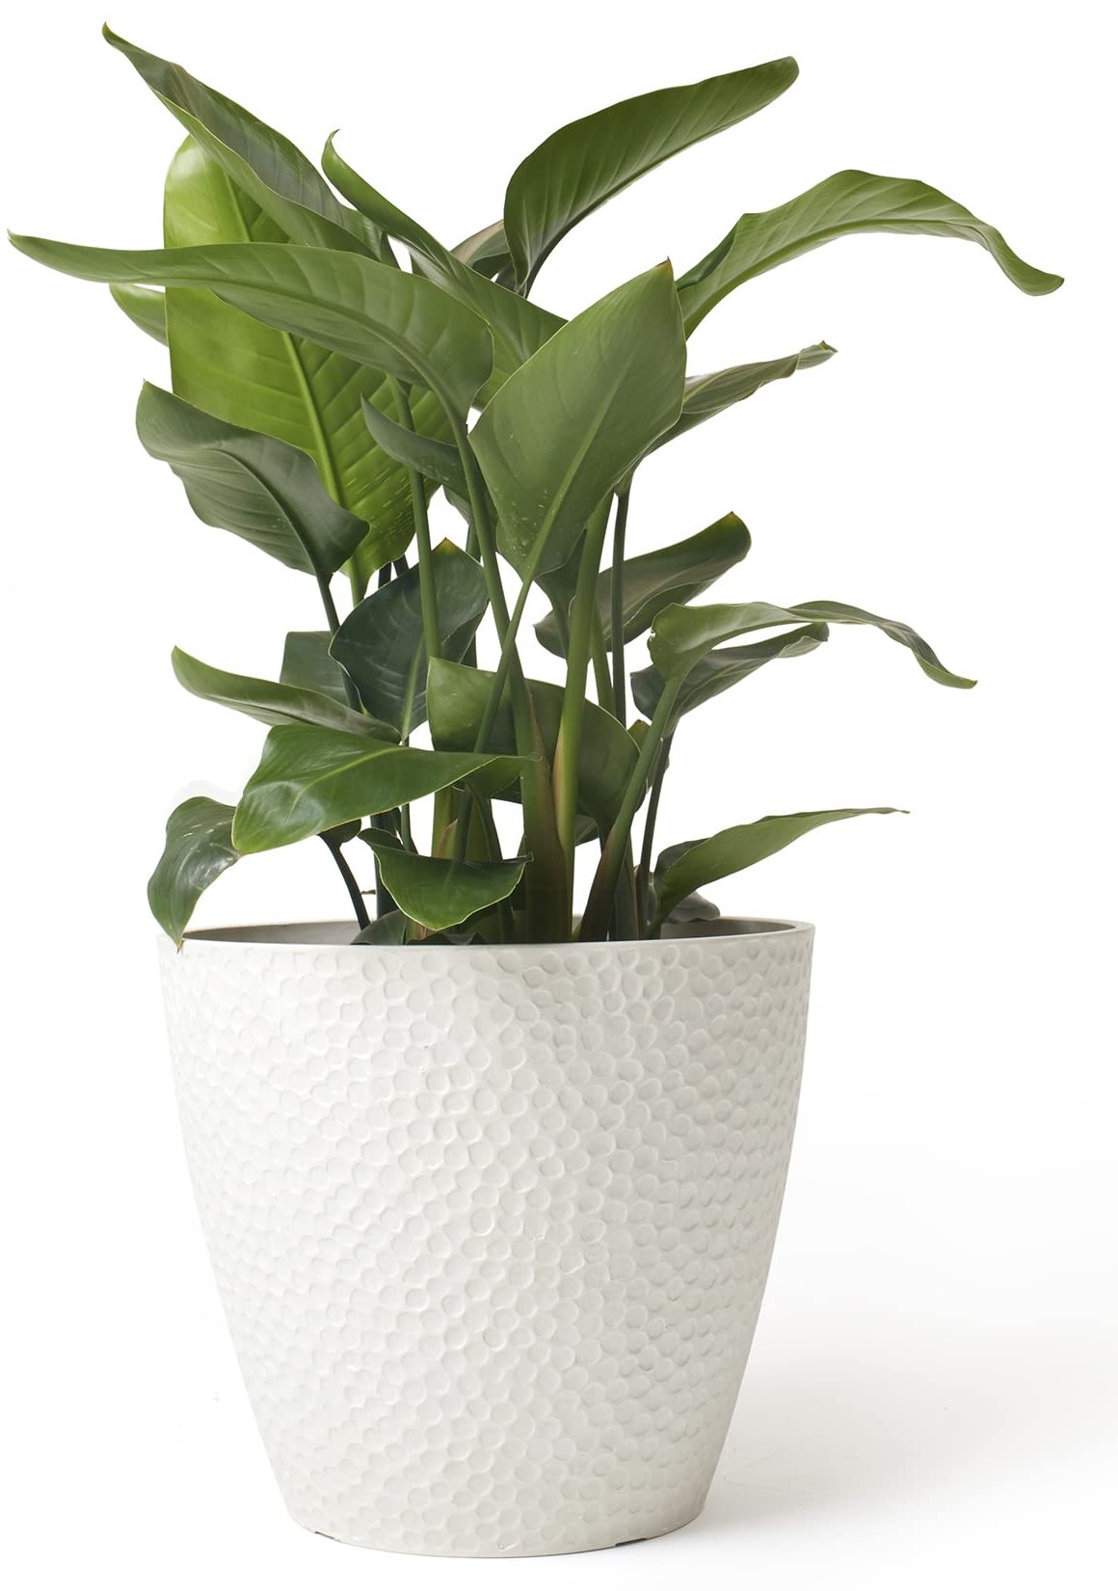
Product Need
Convenience:
No research needed to begin growing plants
Automates some of the hardest parts of gardening.
Plug and play functionality
Accessibility:
Allows those with limited gardening experience to grow plants.
Created with cost efficiency in mind

Slide 4
Product Comparison
 | Sensor Connectivity | Soil Moisture Monitor | Soil Nutrient Monitor | Automated Watering and Fertilizing | Plant Care Recommendations
LetPot | Bluetooth | No | No | Watering | No
Planta | No Sensor (Camera) | No | No | No | Yes
Sinbeda | Bluetooth | Yes | Yes | No | Yes
Our Design | WiFi | Yes | Yes | Yes | Recommended Fertilizing and Watering

Slide 5



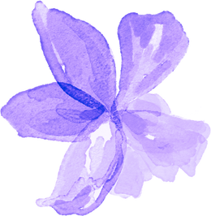



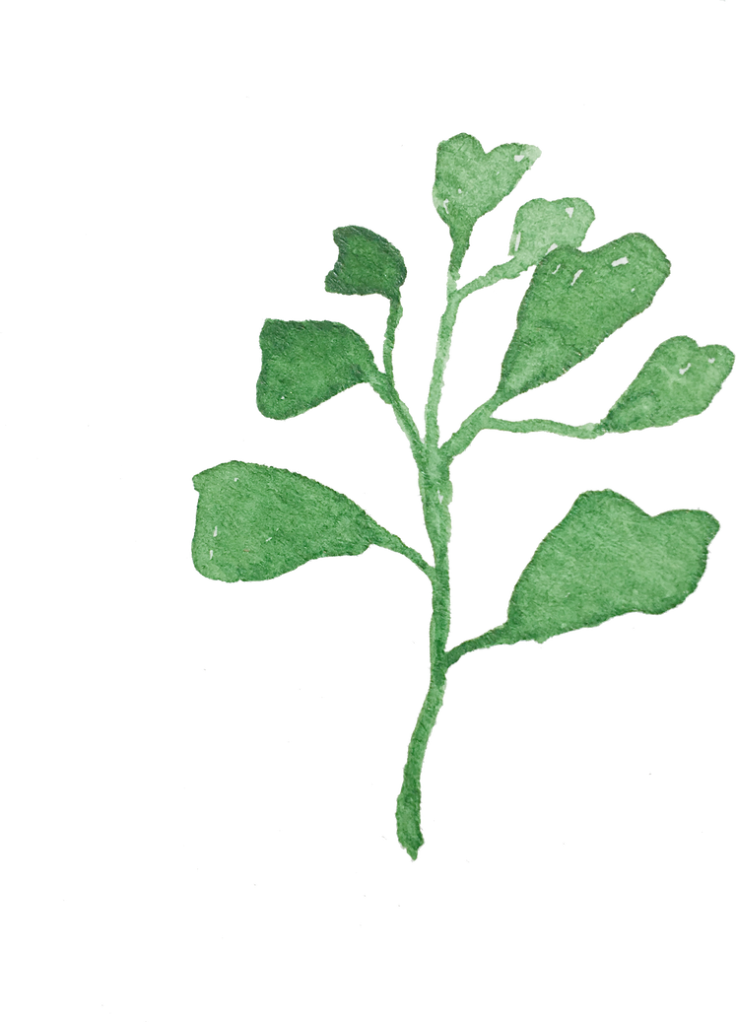
Hardware
Implementation

Slide 6
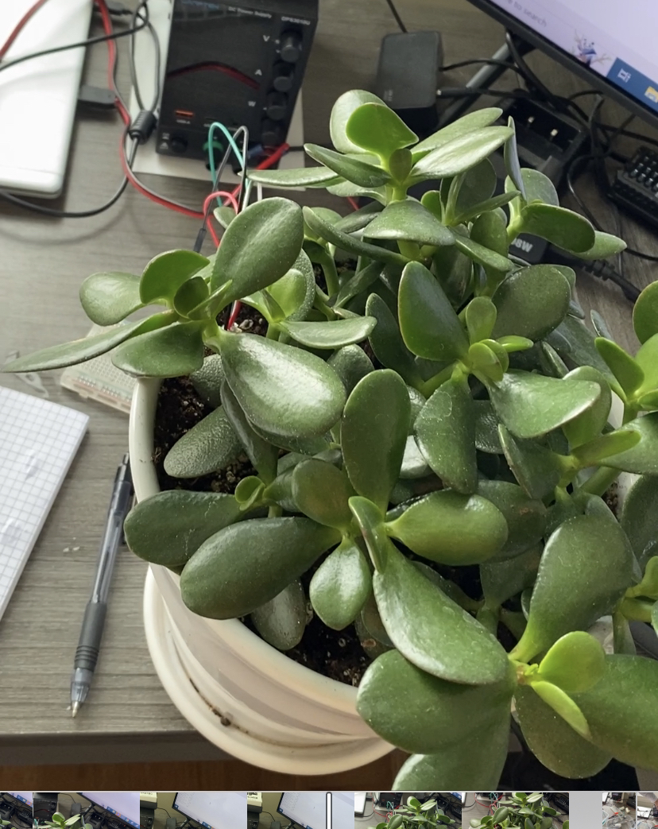
Requirements
Full Hardware Setup
Microcontroller
Sensors + Actuators
Water + Fertilizer Reservoirs
Water Resistant Enclosure (IP55)
Plant Pot Compatibility
Clip to Side of Pot
Wall Powered
Meet all datasheet requirements
Low Power
Increased sustainability

Slide 7
Constraints
Size:
1+ gallon(s) water reservoir for multiple days of watering.
12+ Inch Pot Diameter Compatibility
Power:
The device should be able to run without a charge for at least a month.
Max load shall not exceed 3 Watts
Max idle load shall not exceed 0.5 Watts
Cost:
The total material cost of the device should not exceed $300.

Slide 8
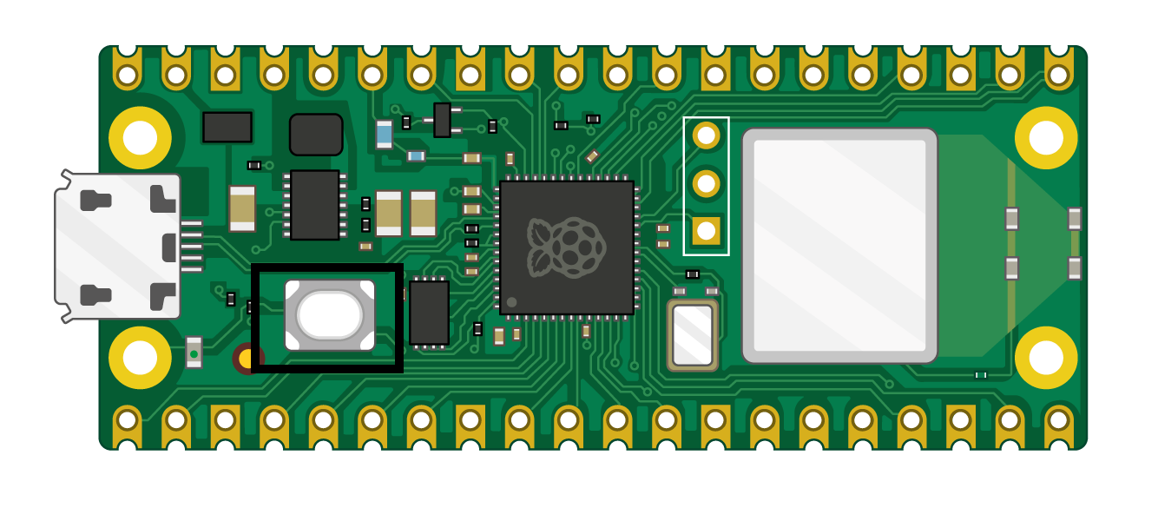
Microcontroller
Pi Pico W
Small Size
Low Cost
Low Power / Heat
Wireless Communication
Good Library Support / Popular
Drawbacks and Limitations
No native Modbus support
Limited built in power options
Other Considered Controllers
Pi 4 / Zero
Arduino MKR1010
No single option offered every desired feature
Notes:
blake

Slide 9
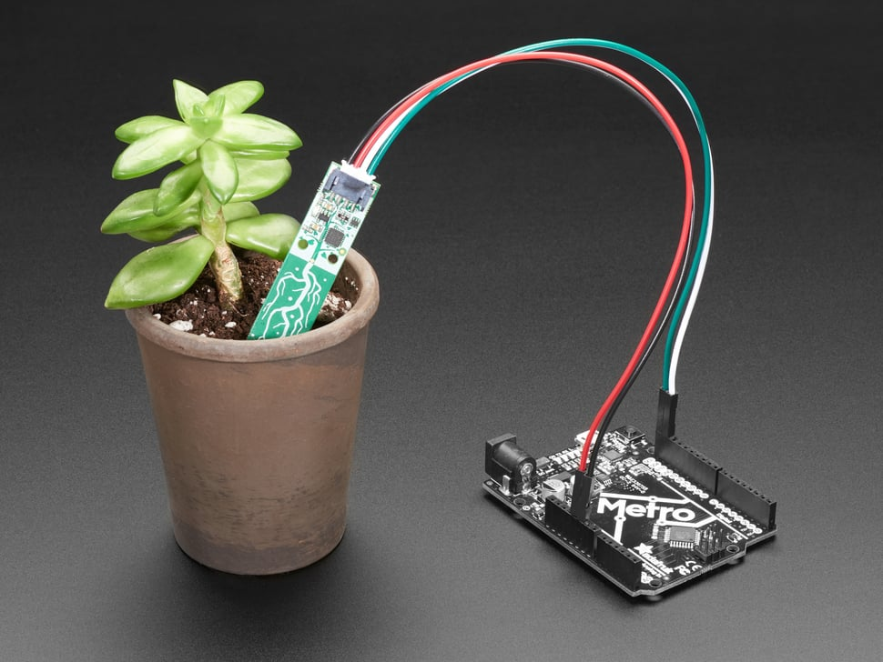
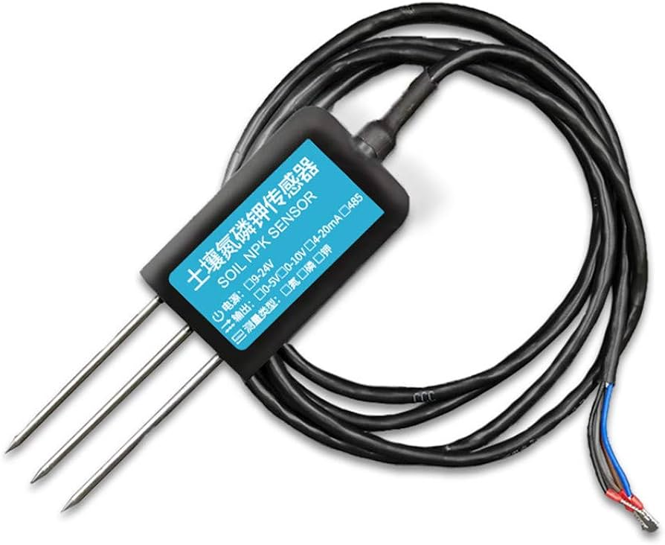
Sensors
Moisture and Temperature
Simple test bed
Easy to use and provides useful data
I2C communication
NPK Sensor
Nitrogen Phosphorus Potassium
More challenging to utilize
RS485
Limited options available
Notes:
blake

Slide 10
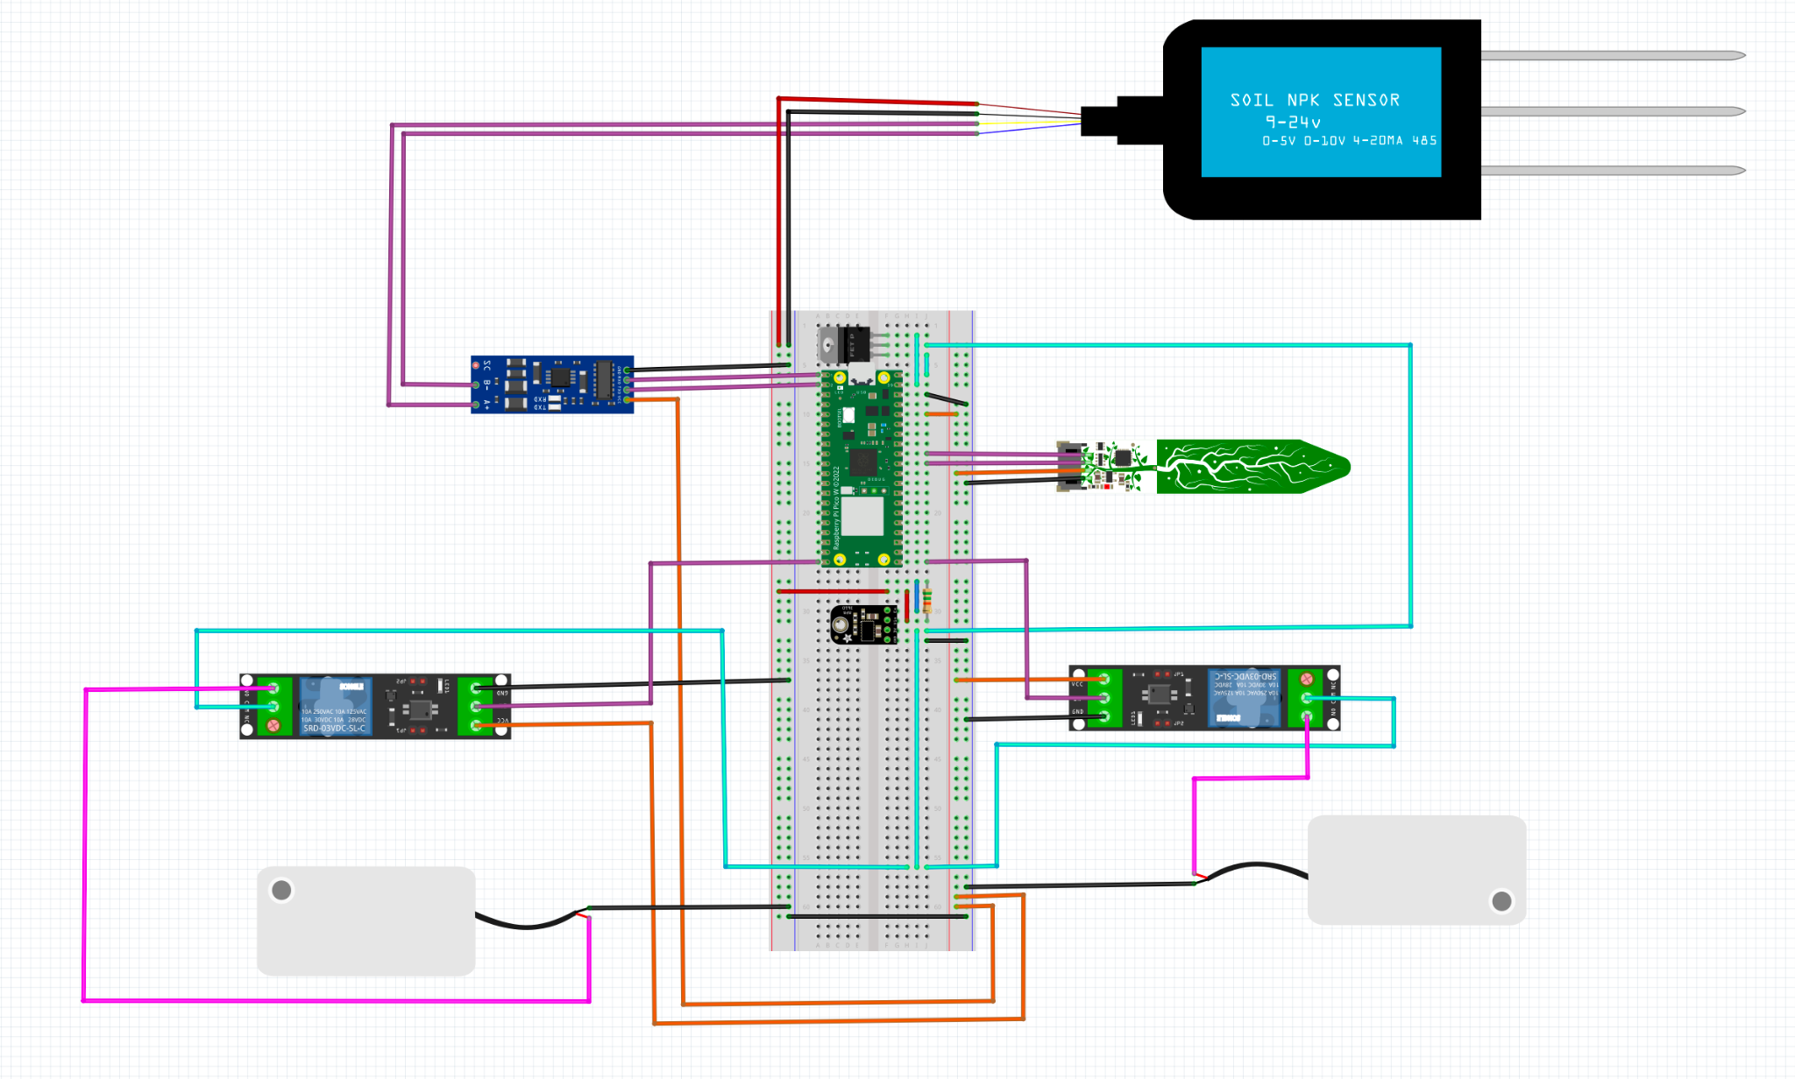
Hardware
Ground
12 V Power
Nitrogen, Phosphorus, and Potassium Sensor
3.3 V Power
Pico Power Out
Switched 3.3V
Communication
RS485 to UART converter
Soil Moisture & Temp. Sensor
Relays
Water Pumps

Slide 11
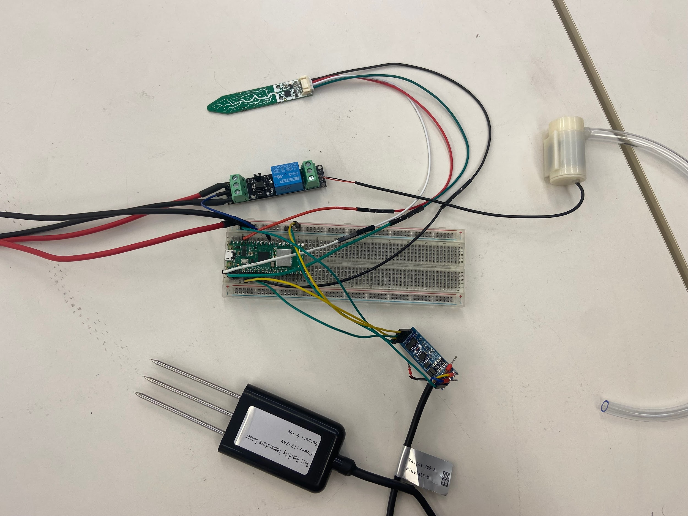
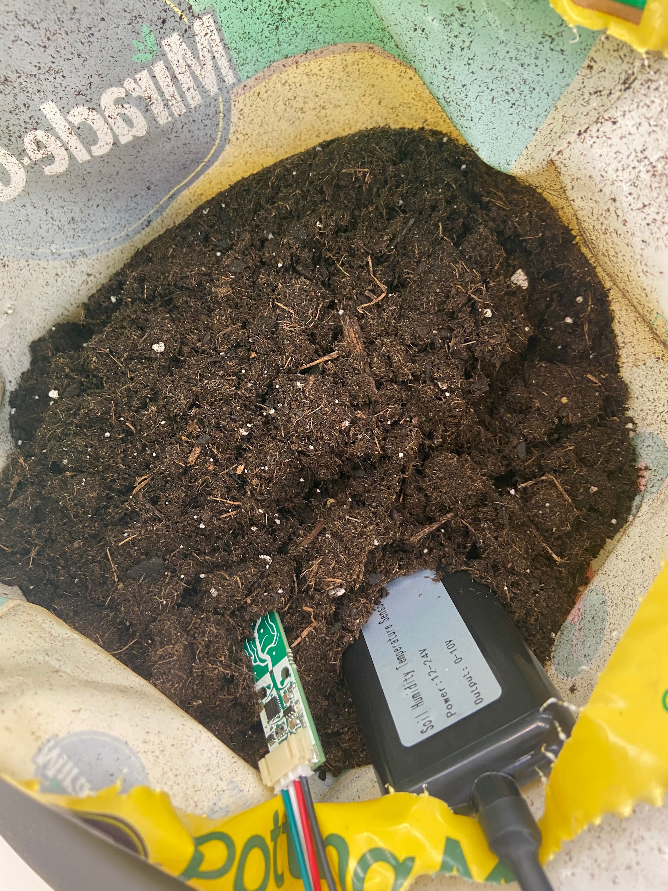
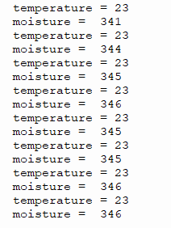
Hardware

Slide 12
Software
Implementation

Slide 13


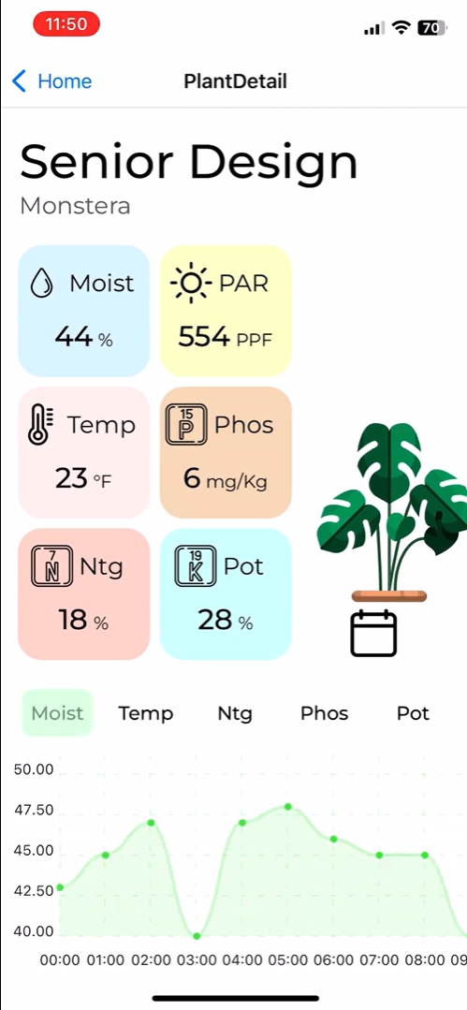
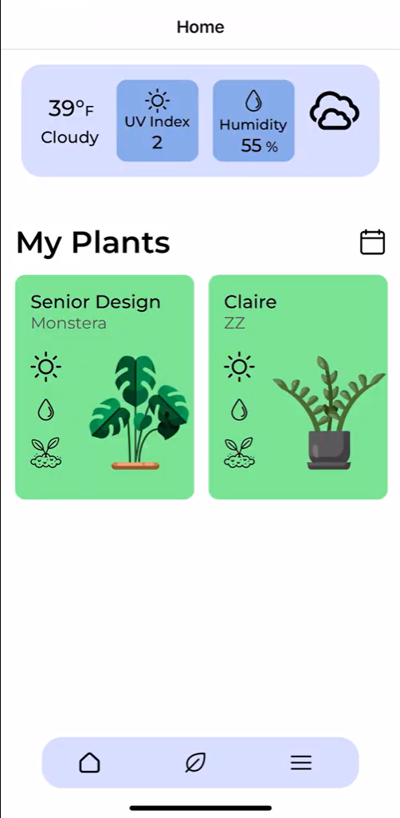
Requirements - UI
User friendly graphical representations of sensor data.
Ability to view past sensor data.
User and plant creation.
Current local weather.

Slide 14
Requirements - UX
Sensor readings updated once per hour.
User friendly design with intuitive functionality. Limited menuing.
Efficient design enabling low load times.

Slide 15
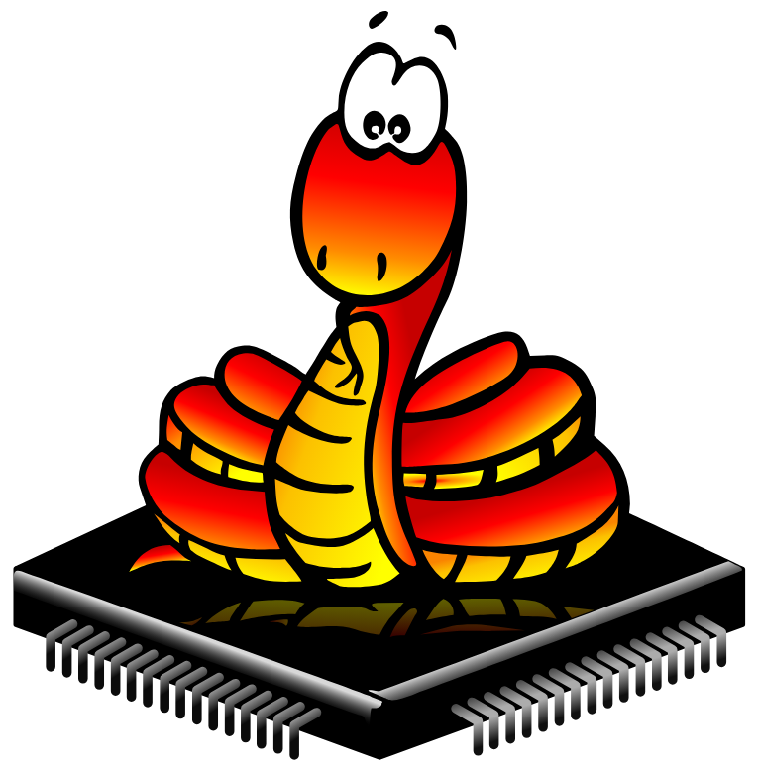


Software & Languages
MicroPython
Easy integration with the Pi Pico W
Well supported by free libraries
MongoDB
Easy free environment setup
High flexibility
Node
Communication between MongoDB and users.
React Native
Live & hot reloading feature allows faster UI development
Cross platform app development possible for iOS and Android
JavaScript across frontend and backend
Notes:
Holden + blake MicroPython is used to control the Pi Pico because of its many libraries and ease of use. Our mobile app stack is MongoDB for storing data Node for front and backend communication and React native for the frontend. This stack was chosen because they all use JavaScript making database interaction easy with JavaScript Object Notation.
MongoDB highly flexible making it easy to change our data format and it offers a free server with good performance for testing.
React Native speeds up development through hot reloads meaning when the code is saved changes instantly load on the emulator.
In addition react native makes it easy to create an Android and IOS apps.

Slide 16
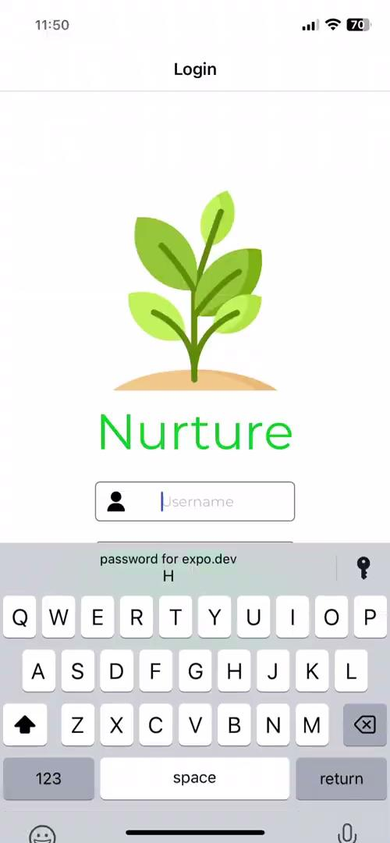
Frontend Demo
Notes:
Holden

Slide 17
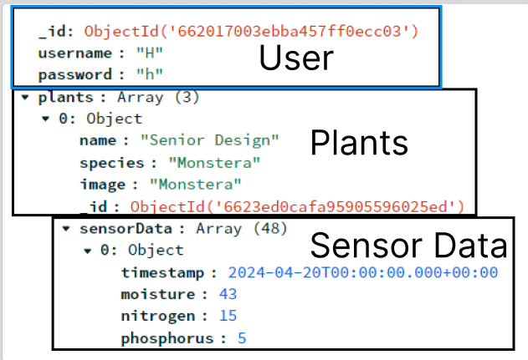
Backend MongoDB with Node
Nested schema setup for easy user management
User has a list of plants
Each plant has a list of sensor data
After login, user is stored within app
MongoDB, Node, and React Native are highly compatible
Asynchronous programming model
Notes:
Holden
Nested schema for easy user management.
User stores a list of plants and each plant has a list of sensor data.
After login the user is stored locally and the database is only updated when the user object changes.
This user management stops excessive interaction between the database and app.
Our backend is asynchronous meaning that if receiving the user is taking a long time it doesnt stop other parts of the app from loading.

Slide 18
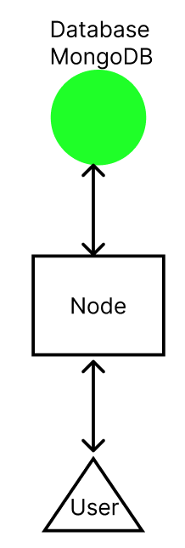
Backend Diagram
Notes:
Holden
Node facilitates the communication between the app and MongoDB by interpreting user requests, receiving MongoDB data and forwarding that to the user.

Slide 19

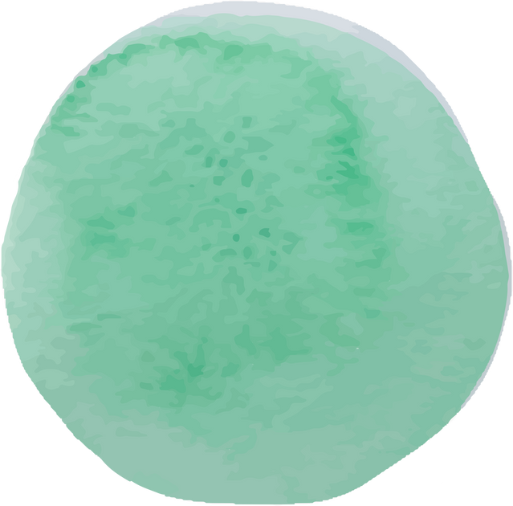
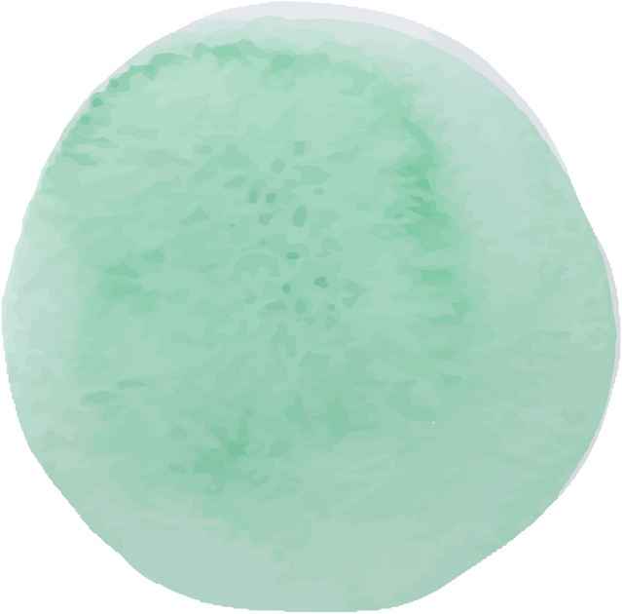
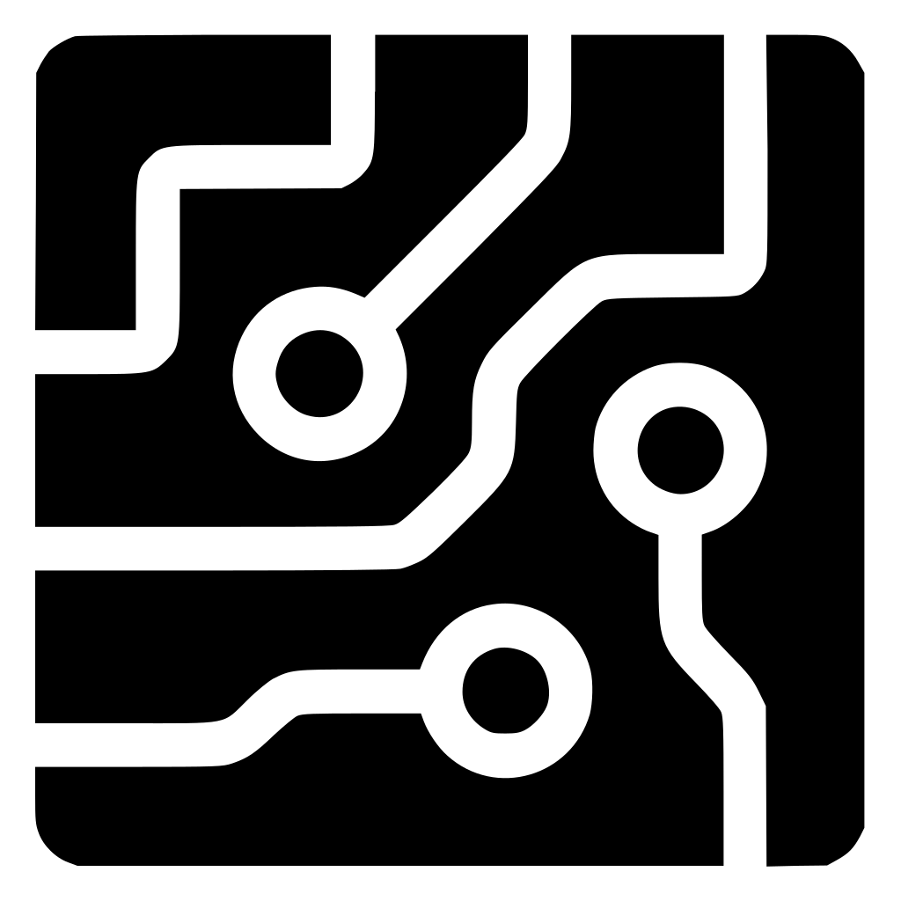

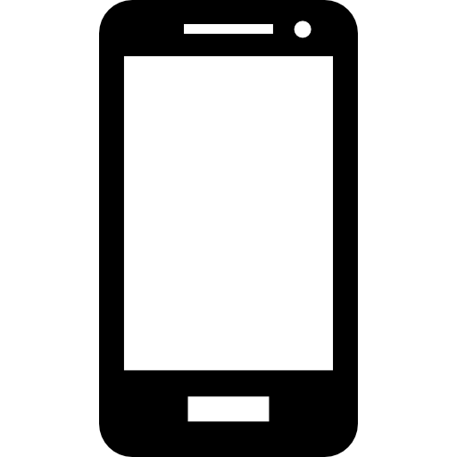

System Overview
Hardware
Backend
Frontend

Slide 20
Timeline
Milestones | Date of Accomplishment
Frontend UI Mockup in Figma | Feb. 12
Initial Prototype Component Selection | Feb. 28
Pump + Moisture Sensor Test with Pi Pico | Apr. 4
Basic UI Functionality in React Native | Apr. 16
MongoDB and Backend Interaction with Frontend | Apr. 16
Full Loop Integration | Sept. 9
NPK Sensor Functionality | Sept. 23
PCB Fabricated and Tested | Nov. 18
Completed Mobile App | Dec. 2
Completed Hardware Setup | Dec. 2
Notes:
midline? middle end makes no sense

Slide 21
Future Plans

Slide 22

Hardware
Enclosure
Justification: IPX5 Water Resistance
Custom PCB
Justification: Form Factor
Power Requirements
Barrel Jack + Wall Outlet Converter
Rechargeable Battery
Buck Converter 12V to 3.3V
Signal Requirements
Trace Routing
Additional Sensors
PAR Wavelength Light Sensor

Slide 23
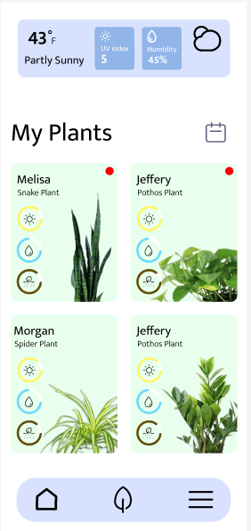
Software Features
Communication between two users to share individual plant information.
Notifications & user set reminders.
Graph full screen capabilities and detailed view.
Quick account creation with Google Gmail.
Websocket communication between the app and Raspberry Pi.
Real time communication.
User control of dispensers.

Slide 24


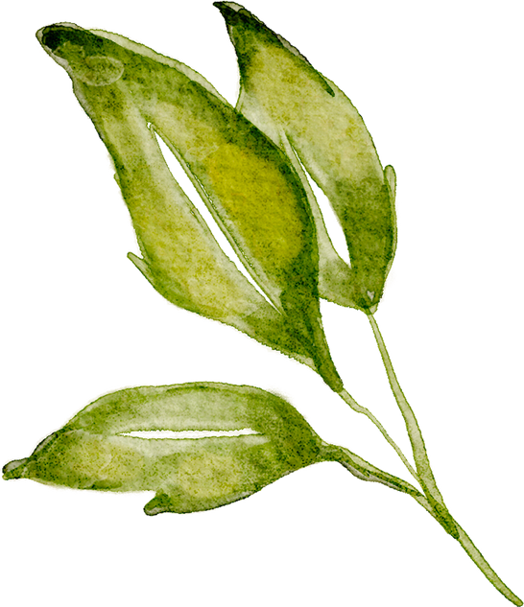



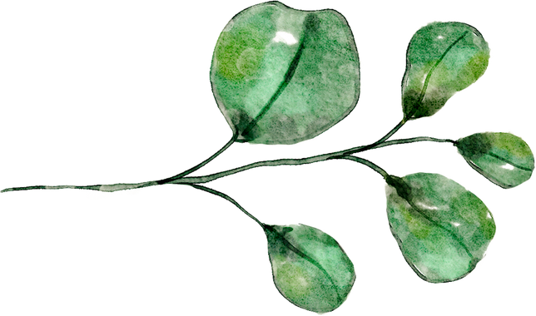
Questions?

